Slide 1
CS221: Algorithms and Data Structures Lecture #2 (Tail) Recursion, Induction, Loop Invariants, and Call Stacks
Steve Wolfman
2014W1
Notes:
TODO (future terms): fix year/term!
TODO (future terms): prep fibonacci and shampoo code to illustrate call stack.

Slide 2
Today’s Outline
Thinking Recursively
Recursion Examples
Analyzing Recursion: Induction and Recurrences
Analyzing Iteration: Loop Invariants
Mythbusters: “Recursion’s not as efficient as iteration”??
Recursion and the Call Stack
Iteration and Explicit Stacks
Tail Recursion (but our KW text is wrong about this!)

Slide 3
Random String Permutations (reigniouS mPRrtmnsdtan aot)
Problem: Permute a string so that every reordering of the string is equally likely. You may use a function randrange(n), which selects a number [0,n) uniformly at random.

Slide 4
Random String Permutations Understanding the Problem
A string is: an empty string or a letter plus the rest of the string.
We want every letter to have an equal chance to end up first. We want all permutations of the rest of the string to be equally likely to go after.
And.. there’s only one empty string.
(Tests: tricky, but result should always have same letters as orginal.)

Slide 5
Random String Permutations Algorithm
PERMUTE(s): if s is empty, just return s else: use randRange to choose a random first letter permute the rest of the string (minus that random letter) return a string that starts with the random letter and continues with the permuted rest of the string

Slide 6
Random String Permutations Converting Algorithm to Code
PERMUTE(s): if s is empty, just return s else: choose random letter permute the rest return random letter + rest
Notes:
C++11-style code (ignoring the fact that algorithm already has a permutation function in it!):
#include <chrono> // for seeding w/time
#include <random>
#include <iostream>
int choose_random_index(std::string const & str) {
static unsigned seed = std::chrono::system_clock::now().time_since_epoch().count();
static std::default_random_engine generator(seed);
std::uniform_int_distribution<int> distribution(0,str.size()-1);
return distribution(generator);
}
std::string permute(std::string str) {
// if s is empty
if (str.size() == 0) {
// just return s
return str;
} else {
// choose random letter
int index = choose_random_index(str);
char c = str[index];
// permute the rest
std::string rest = str.erase(index, 1);
std::string rest_permuted = permute(rest);
// return random letter + rest
return c + rest_permuted;
}
}
int main(int argc, char *argv[]) {
if (argc != 2) {
std::cerr << "Usage: " << argv[0] << " <string>" << std::endl;
std::cerr << "\tPermutes <string> randomly and prints the result." << std::endl;
return -1;
}
std::string str(argv[1]);
std::cout << permute(str) << std::endl;
}

Slide 7
Thinking Recursively
DO NOT START WITH CODE. Write the story of the problem, including the data definition!
Define the problem: What should be done given a particular input?
Solve some example cases by hand.
Identify and solve the (usually simple) base case(s).
Figure out how to break the complex cases down in terms of any smaller case(s). For the smaller cases, call the function recursively and assume it works. Do not think about how!

Slide 8
Implementing Recursion (REMINDER!)
Once you have all that, write out your solution in comments (a “template”). Then fill out the code and test.
(Should be easy… if it’s hard, maybe you’re not assuming your recursive call works!)

Slide 9
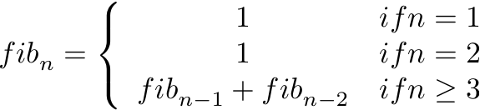
Recursion Example: Fibs (SKIPPING in class)
Problem: Calculate the n^{th} Fibonacci number, from the sequence 1, 1, 2, 3, 5, 8, 13, 21, 34, 55, ...
First two numbers are 1; each succeeding number is the sum of the previous two numbers:
Notes:
Rabbit population simulation: 1. Each pair of mature rabbits has one baby/month. 2. Rabbits mature at month two. 3. Rabbits are immortal.

Slide 10
Fibs, Worked, First Pass (SKIPPING in class)
Problem: Calculate the n^{th} Fibonacci number, from the sequence 1, 1, 2, 3, 5, 8, 13, 21, 34, 55, ...
int fib(int n) {
if (n <= 2) return 1;
else return fib(n-1) + fib(n-2);
}

Slide 11
Today’s Outline
Thinking Recursively
Recursion Examples
Analyzing Recursion: Induction and Recurrences
Analyzing Iteration: Loop Invariants
Mythbusters: “Recursion’s not as efficient as iteration”??
Recursion and the Call Stack
Iteration and Explicit Stacks
Tail Recursion (but our KW text is wrong about this!)

Slide 12
Induction and Recursion, Twins Separated at Birth?
Base case
Prove for some small value(s).
Inductive Step
Break a larger case down into smaller ones that we assume work (the Induction Hypothesis).
Base case
Calculate for some small value(s).
Otherwise, break the problem down in terms of itself (smaller versions) and then call this function to solve the smaller versions, assuming it will work.

Slide 13
Proving a Recursive Function Correct with Induction is EASY
Just follow your code’s lead and use induction.
Your base case(s)? Your code’s base case(s).
How do you break down the inductive step? However your code breaks the problem down into smaller cases.
What do you assume? That the recursive calls just work (for smaller input sizes as parameters, which better be how your recursive code works!).

Slide 14
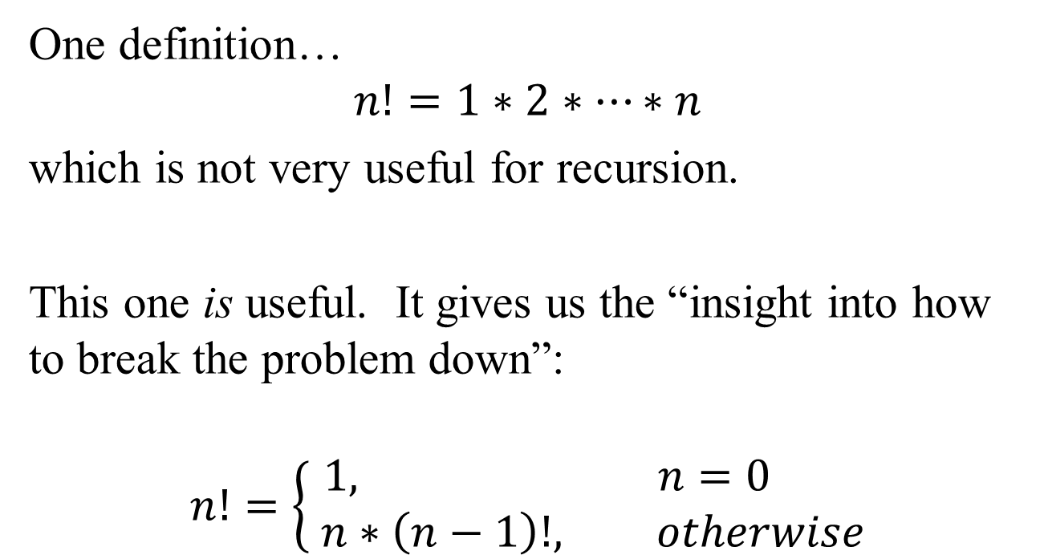
Reminder: Factorial

Slide 15
Proving a Recursive Function Correct with Induction is EASY
// Precondition: n >= 0.
// Postcondition: returns n!
int factorial(int n)
{
if (n == 0)
return 1;
else
return n*factorial(n-1);
}
Prove: factorial(n) = n!
Base case: n = 0.
Our code returns 1 when n = 0, and 0! = 1 by definition. ✓
Inductive step: For some k > 0, our code returns k*factorial(k-1). By IH, factorial(k-1) = (k-1)! and k! = k*(k-1)! by definition. QED
ALWAYS connect what the code does with what you want to prove.
Notes:
May be worth discussing where the proof breaks down when respecting the issues of number representation (which is (mostly only) at the point where we equate * with multiplication.

Slide 16
Proving A Recursive Algorithm Works
Problem: Prove that our algorithm for randomly permuting a string gives an equal chance of returning every permutation (assuming randrange(n) works as advertised).
Notes:
Base case: an empty string cannot be permuted; so returning the empty string is correct.
Induction hypothesis: Assume that our call to permute(substr) works (uniformly randomly permutes substr).
We choose the first letter uniformly at random from across the string. To get a random permutation, we need only randomly permute the remaining letters. When we call permute(substr), it does exactly that.
QED.

Slide 17
Recurrence Relations… Already Covered
See METYCSSA #5-7.
Additional Problem: Prove binary search takes O(lg n) time.
// Search array[left..right] for target.
// Return its index or the index where it should go.
int bSearch(int array[], int target, int left, int right)
{
if (right < left) return left;
int mid = (left + right) / 2;
if (target <= array[mid])
return bSearch(array, target, left, mid-1);
else
return bSearch(array, target, mid+1, right);
}

Slide 18
Binary Search Problem (Worked)
Note: Let n be # of elements considered in the array (right – left + 1).
int bSearch(int array[], int target, int left, int right)
{
if (right < left) return left;
int mid = (left + right) / 2;
if (target <= array[mid])
return bSearch(array, target, left, mid-1);
else
return bSearch(array, target, mid+1, right);
}
O(1), base case
O(1)
O(1)
~T(n/2)
~T(n/2)

Slide 19
Binary Search Problem (Worked)
For n=0: T(0) = 1
For n>0: T(n) = T(⎣n/2⎦) + 1
To guess at the answer, we simplify:
For n=1: T(1) = 1
For n>1: T(n) = T(n/2) + 1
T(n) = (T(n/4) + 1) + 1
T(n) = T(n/4) + 2
T(n) = T(n/8) + 3
T(n) = T(n/16) + 4
T(n) = T(n/(2^{i})) + i
Change ⎣n/2⎦ to n/2.
Change base case to T(1) (We’ll never reach 0 by dividing by 2!)
Sub in T(n/2) = T(n/4)+1
Sub in T(n/4) = T(n/8)+1
Sub in T(n/8) = T(n/16)+1

Slide 20
Binary Search Problem (Worked)
To guess at the answer, we simplify:
For n=1: T(1) = 1
For n>1: T(n) = T(n/2) + 1
For n>1: T(n) = T(n/(2^{i})) + i
To reach the base case, let n/2^{i} = 1
n = 2^{i} means i = lg n
T(n) = T(n/2^{lg n}) + lg n = T(1) + lg n = lg n + 1
T(n) ∈ O(lg n)
Why did that work out so well?

Slide 21
Binary Search Asymptotic Performance, Proof by Induction
For n=0: T(0) = 1
For n>0: T(n) = T(⎣n/2⎦) + 1
T(1) = T(0) + 1 = 2
T(2) = T(3) = T(1) + 1 = 3.
Prove T(n) ∈ O(lg n)
Let c = 3, n₀ = 2.
Show for all n ≥ n₀, T(n) ≤ c lg n.
Base cases: T(2) = 3 = 3 lg 2 ✓
Base cases: T(3) = 3 ≤ 3 lg 3 ✓
Set n₀ = 2 because lg 0 is undefined and lg 1 = 0.
We want c lg 2 ≥ T(2) and we know T(2) = 3. Solve for c: c ≥ 3/lg 2 = 3.

Slide 22
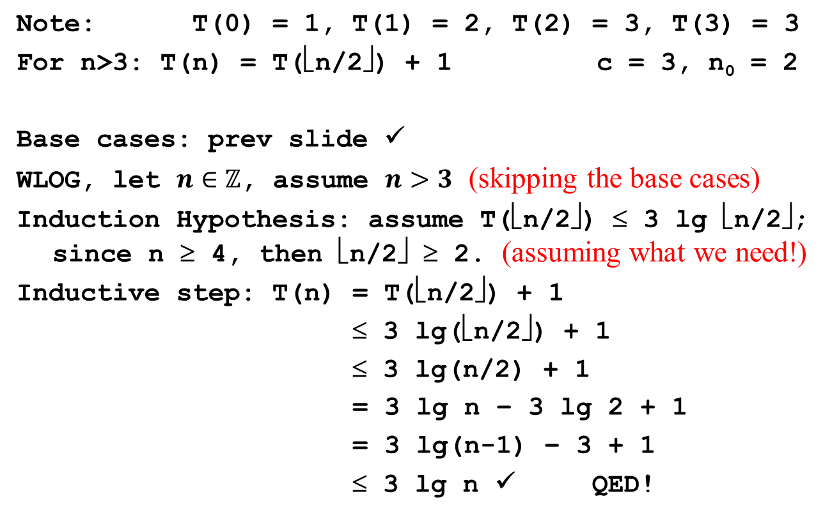
Binary Search Problem (Worked)

Slide 23
Today’s Outline
Thinking Recursively
Recursion Examples
Analyzing Recursion: Induction and Recurrences
Analyzing Iteration: Loop Invariants
Mythbusters: “Recursion’s not as efficient as iteration”??
Recursion and the Call Stack
Iteration and Explicit Stacks
Tail Recursion (but our KW text is wrong about this!)

Slide 24
(Tail) Recursive → Iterative
It’s often simple to convert a recursive function to an iterative one (and vice versa).
int bSearch(int array[], int target, int left, int right)
{
while (!(right < left))
int mid = (left + right) / 2;
if (target <= array[mid])
right = mid – 1;
else
left = mid + 1;
}
return left;
}
if (right < left) return left;
int mid = (left + right) / 2;
if (target <= array[mid])
return bSearch(array,target,left, mid-1);
else
return bSearch(array, target, mid+1, right);

Slide 25
Analyzing Loops
Maybe we can use the same techniques we use for proving correctness of recursion to prove correctness of loops...
We do this by stating and proving “invariants”, properties that are always true (don’t vary) at particular points in the program.
One way of thinking of a loop is that we spend each loop iteration fixing the invariant for the next iteration.

Slide 26
Insertion Sort
(invariant)
int insertionSort(int array[], int length)
{
// Invariant: before each test i < length (including the last
// one), the elements in array[0..i-1] are in sorted order.
for (int i = 1; i < length; i++)
{
// i is about to go up by 1 but array[i] may be out of order!
// gotta fix it gotta fix it gotta fix it!!!
int val = array[i];
int newIndex = bSearch(array, val, 0, i);
for (int j = i; j > newIndex; j--)
array[j] = array[j-1];
array[newIndex] = val;
}
}
(invariant anxiety)

Slide 27
Proving a Loop Invariant
Induction variable: number of times through the loop.
Base case: Prove the invariant true before the first loop guard test.
Induction hypothesis: Assume the invariant holds just before some (unspecified) iteration’s loop guard test.
Inductive step: Prove the invariant holds at the end of that iteration (just before the next loop guard test).
Extra bit: Make sure the loop will eventually end!
We’ll prove insertion sort works, but the cool part is not proving it works (duh).
The cool part is that the proof is a natural way to think about it working!

Slide 28
Proving Insertion Sort Works
// Invariant: before each test i < length (including the last
// one), the elements in array[0..i-1] are in sorted order.
for (int i = 1; i < length; i++)
{
// i is about to go up by 1 but array[i] may be out of order!
int val = array[i];
int newIndex = bSearch(array, val, 0, i);
for (int j = i; j > newIndex; j--)
array[j] = array[j-1];
array[newIndex] = val;
}
Base case (just before “1 < length”): array[0..0] has one element; so, it’s always in sorted order.
What’s the niggly detail we skipped here?
Notes:
Length of 0!

Slide 29
Proving Insertion Sort Works
// Invariant: before each test i < length (including the last
// one), the elements in array[0..i-1] are in sorted order.
for (int i = 1; i < length; i++)
{
// i is about to go up by 1 but array[i] may be out of order!
int val = array[i];
int newIndex = bSearch(array, val, 0, i);
for (int j = i; j > newIndex; j--)
array[j] = array[j-1];
array[newIndex] = val;
}
Induction hypothesis: just before we test k < length, array[0..k-1] are in sorted order. (When the loop starts, i = k.)

Slide 30
Proving Insertion Sort Works
// Invariant: before each test i < length (including the last
// one), the elements in array[0..i-1] are in sorted order.
for (int i = 1; i < length; i++)
{
// i is about to go up by 1 but array[i] may be out of order!
int val = array[i];
int newIndex = bSearch(array, val, 0, i);
for (int j = i; j > newIndex; j--)
array[j] = array[j-1];
array[newIndex] = val;
}
Inductive Step: bSearch gives the appropriate index at which to put array[i]. So, the new element ends up in sorted order, and the rest of array[0..i] stays in sorted order.
(A bit hand-wavy… what should we have done?)
(surprisingly: linear search may be a better choice here; ask after class!)

Slide 31
Proving Insertion Sort Works
// Invariant: before each test i < length (including the last
// one), the elements in array[0..i-1] are in sorted order.
for (int i = 1; i < length; i++)
{
// i is about to go up by 1 but array[i] may be out of order!
int val = array[i];
int newIndex = bSearch(array, val, 0, i);
for (int j = i; j > newIndex; j--)
array[j] = array[j-1];
array[newIndex] = val;
}
Loop termination: The loop ends when i == length (which it must be eventually since length is non-negative and i increases). At which point, array[0..i-1] is sorted… which is array[0..length-1] or the whole array

Slide 32
Practice: Prove the Inner Loop Correct
for (int i = 1; i < length; i++)
{
// i is about to go up by 1 but array[i] may be out of order!
int val = array[i];
int newIndex = bSearch(array, val, 0, i);
// What’s the invariant? Maybe: just before j > newIndex,
// “array[0..j-1] + array[j+1..i] = the old array[0..i-1]”
for (int j = i; j > newIndex; j--)
array[j] = array[j-1];
array[newIndex] = val;
}
We just waved our hands at the inner loop. Prove it’s correct! (This may feel unrealistically easy!)
Do note that j is going down, not up.

Slide 33
Today’s Outline
Thinking Recursively
Recursion Examples
Analyzing Recursion: Induction and Recurrences
Analyzing Iteration: Loop Invariants
Mythbusters: “Recursion’s not as efficient as iteration”??
Recursion and the Call Stack
Iteration and Explicit Stacks
Tail Recursion (but our KW text is wrong about this!)

Slide 34
Mythbusters: Recursion vs. Iteration
Which one can do more? Recursion or iteration?

Slide 35
Mythbusters: Simulating a Loop with Recursion
int i = 0
while (i < n)
doFoo(i)
i++
recDoFoo(0, n)
Where recDoFoo is:
void recDoFoo(int i, int n)
{
if (i < n) {
doFoo(i)
recDoFoo(i + 1, n)
}
}
Anything we can do with iteration, we can do with recursion.

Slide 36
Mythbusters: Simulating Recursion with a Stack (Going Quick.. Already Discussed)
How does fib actually work?
Each function call generates a stack frame (also known as activation record or, just between us, function pancake) holding local variables and the program point to return to, which is pushed on a stack (the call stack) that tracks the current chain of function calls.
int fib(int n) {
if (n <= 2) return 1;
else return fib(n-1) + fib(n-2);
}
cout << fib(4) << endl;

Slide 37
Mythbusters: Simulating Recursion with a Stack (Going Quick.. Already Discussed)
How does fib actually work?
int fib(int n) {
if (n <= 2) return 1;
else return fib(n-1) + fib(n-2);
}
cout << fib(4) << endl;
The call (or “run-time”) stack
fib(2)
fib(3)
fib(4)
main
fib(3)
fib(4)
main
fib(1)
fib(3)
fib(4)
main
fib(3)
fib(4)
main
fib(3)
fib(4)
main
fib(2)
fib(4)
main
fib(4)
main
fib(4)
main
fib(4)
main
main
main
Time

Slide 38
Aside: Efficiency and the Call Stack
The height of the call stack tells us the maximum memory we use storing the stack.
The number of calls that go through the call stack tells us something about time usage. (The # of calls multiplied by worst-case time per call bounds the asymptotic complexity.)
height = 4 frames
fib(2)
fib(3)
fib(4)
main
fib(3)
fib(4)
main
fib(1)
fib(3)
fib(4)
main
fib(3)
fib(4)
main
fib(3)
fib(4)
main
fib(2)
fib(4)
main
fib(4)
main
fib(4)
main
fib(4)
main
main
main
So, when calculating memory usage, we must consider stack space!
But only the non-tail-calls count… see later slides on tail recursion and tail calls.

Slide 39
Aside: Limits of the Call Stack
int fib(int n) {
if (n == 1) return 1;
else if (n == 2) return 1;
else return fib(n-1) + fib(n-2);
}
cout << fib(0) << endl;
What will happen?
Returns 1 immediately.
Runs forever (infinite recursion)
Stops running when n “wraps around” to positive values.
Bombs when the computer runs out of stack space.
None of these.
Notes:
[From 2011W2:] Run: ~cs221/World/2011W2/handouts/wolfman/fib.cc
Edit to show argument value.

Slide 40
Mythbusters: Simulating Recursion with a Stack
How do we simulate fib with a stack?
That’s what our computer already does. We can sometimes do it a bit more efficiently by only storing what’s really needed on the stack:
int fib(int n)
result = 0
push(n)
while not isEmpty
n = pop
if (n <= 2) result++;
else push(n – 1); push(n – 2)
return result
OK, this is cheating a bit (in a good way). To get down and dirty, see CPSC 313 + 311.

Slide 41
Mythbusters: Recursion vs. Iteration
Which one is more elegant? Recursion or iteration?

Slide 42
Mythbusters: Recursion vs. Iteration
Which one is more efficient? Recursion or iteration?

Slide 43
Accidentally Making Lots of Recursive Calls; Recall...
Recursive Fibonacci:
int Fib(n)
if (n == 0 or n == 1) return 1
else return Fib(n - 1) + Fib(n - 2)
Lower bound analysis
T(0), T(1) >= b
T(n) >= T(n - 1) + T(n - 2) + c if n > 1
Analysis
let φ be (1 + √5)/2 which satisfies φ² = φ + 1
show by induction on n that T(n) >= bφ^{n - 1}
Already discussed Day 1.. Skipping.

Slide 44
Accidentally Making Lots of Recursive Calls; Recall...
int Fib(n)
if (n == 1 or n == 2) return 1
else return Fib(n - 1) + Fib(n - 2)
Finish the recursion tree for Fib(5)…
Fib(5)
Fib(4)
Fib(3)
Already discussed Day 1.. Skipping.

Slide 45
Fixing Fib: Requires Iteration?
What we really want is to “share” nodes in the recursion tree:
Fib(5)
Fib(4)
Fib(3)
Fib(2)
Fib(1)
Already discussed Day 1.. Skipping.

Slide 46
Fixing Fib with Iteration and “Dynamic Programming”
Here’s one fix that “walks up” the left of the tree:
int fib_dp(int n)
{
if (n == 1) return 1;
int fib = 1, fib_old = 1;
int i = 2;
while (i < n) {
int fib_new = fib + fib_old;
fib_old = fib;
fib = fib_new;
i++;
}
return fib;
}
Fib(5)
Fib(4)
Fib(3)
Fib(2)
Fib(1)
Already discussed Day 1.. Skipping.

Slide 47
Fixing Fib with Recursion and “Memoizing”
Here’s another fix that just takes note of problems it’s solved before:
int[] fib_solns = new int[large_enough]; // init to 0
fib_solns[1] = 1;
fib_solns[2] = 1;
int fib_memo(int n)
{
// If we don’t know the answer…
if (fib_solns[n] == 0)
fib_solns[n] = fib_memo(n-1) +
fib_memo(n-2);
return fib_solns[n];
}
Fib(5)
Fib(4)
Fib(3)
Fib(2)
Fib(1)
Already discussed Day 1.. Skipping.

Slide 48
Fixing Fib with Recursion and Pure Functional Programming
In a “pure functional” programming language (like Haskell and a subset of Racket), the interpreter can (but may not) notice that nodes in the graph are the same and share them.
Fib(5)
Fib(5)
Fib(4)
Fib(3)
Fib(4)
Fib(3)
Fib(2)
Fib(2)
Fib(1)
Fib(3)
Fib(2)
Fib(1)
Fib(2)
Fib(1)
Why? Because Fib(n) can never return two different values in a pure functional language.

Slide 49
Mythbusters: Recursion vs. Iteration
Which one is more efficient? Recursion or iteration?
It’s probably easier to shoot yourself in the foot without noticing when you use recursion, and the call stack may carry around a bit more (a constant factor more) memory than you really need to store, but otherwise…
Neither is more efficient.
Before we move, on, let’s lather, rinse, and repeat.
Notes:
[From 2011W2] Endlessly greet!
Do code.
~cs221/World/2011W2/handouts/wolfman/endlessly-greet.cc

Slide 50
Managing the Call Stack: Tail Recursion
void shampoo()
{
cout << "Lather, Rinse" << endl;
shampoo();
}
This is clearly infinite recursion. The call stack will get as deep as it can get and then bomb, right?
But... why? What work is the call stack doing?
There’s nothing to remember on the stack!
Try compiling it with at least –O2 optimization and running. It won’t give a stack overflow!

Slide 51
Tail Call (should be CPSC 110 review!)
A function call is a “tail call” if that call is the absolute last thing the function needs to do before returning.
In that case, why bother pushing a new stack frame? There’s nothing to remember. Just re-use the old frame.
That’s what most compilers will do (although Java has had some issues with this!).

Slide 52
Tail Recursion (should be CPSC 110 review!)
A function is “tail recursive” if all of its recursive calls are tail calls (i.e., each recursive call in the function is the absolute last thing the function needs to do before returning).
Can two calls both be the last thing that needs to be done before the function returns?
Sure: consider binary search: we recurse to the left or to the right, but not both.
WARNING: Koffman and Wolfgang text is wrong about this!
Having a (or even “the”) recursive call on the last line is not enough.

Slide 53
Tail Recursive?
int fib(int n) {
if (n <= 2) return 1;
else return fib(n-1) + fib(n-2);
}
Tail recursive?
Yes.
No.
Not enough information.

Slide 54
Tail Recursive?
int factorial(int n) {
if (n == 0) return 1;
else return n * factorial(n – 1);
}
Tail recursive?
Yes.
No.
Not enough information.

Slide 55
Tail Recursive?
int factorial(int n) { return fact_acc(n, 1); }
int fact_acc (int n, int acc) {
if (n == 0) return acc;
else return fact_acc(n – 1, acc * n);
}
Tail recursive?
Yes.
No.
Not enough information.

Slide 56
Tail Calls
int fact(int n) { return fact_acc(n, 1); }
int fact_acc (int n, int acc) {
if (n == 0) return acc;
else return fact_acc(n – 1, acc * n);
}
The call to fact_acc in factorial is a tail call and therefore also need not consume extra stack space.

Slide 57
To Do
CPSC 121 Review: Epp 4.2-4.4, 5.1-5.2, 7.1-7.2
Read: Epp 4.5, Koffman/Wolfgang Chapter 7
Notes:
TODO (future terms): update

Slide 58
Coming Up
One of (TBD!):
Priority Queues
Trees
Notes:
TODO (future terms): update

